Slide 1

Louisiana Solar Energy Laboratory
Summer Research Internship

Slide 2
An Analytical Study on the Design of Solar Power Plants for
Residential and Commercial Sector: Practical Implementation and Cost Analysis
Supervised by Terrence L. Chambers, Ph.D., P.E.
Donald & Janice Mosing BORSF Endowed Chair in Mechanical Engineering
Director, EDA Green Hydrogen Center of Excellence
Director, Energy Efficiency and Sustainable Energy Center
University of Louisiana at Lafayette
Presented by ROY Jui

Slide 3
Problem Statement
Challenge in Robust Model Development
Real-World Implementation Barriers
Complexity in Electrical and Mechanical Design
Uncertainty in Economic Viability

Slide 4
Develop site-specific PV system models
Address real-world constraints in design and implementation
Evaluate economic feasibility via LCOE, payback, etc.
Research Goal

Slide 5
Apply design theories through hands-on experience
Objectives
of the
Internship
Conduct site surveys, system sizing, energy simulation
Analyze economic performance using real data

Slide 6

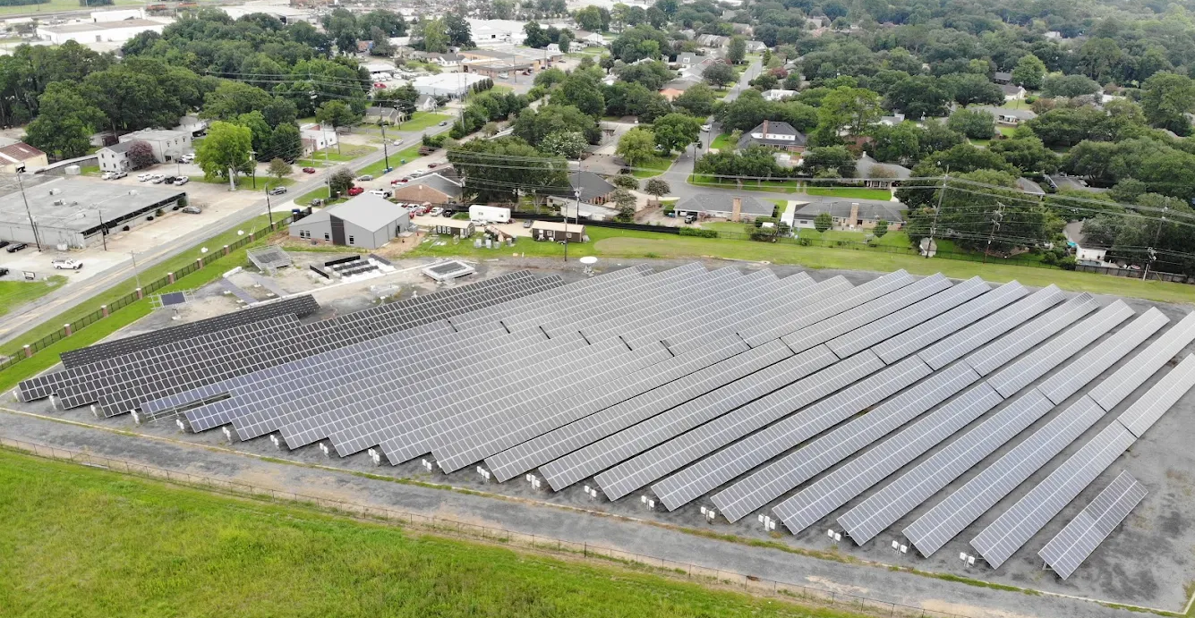
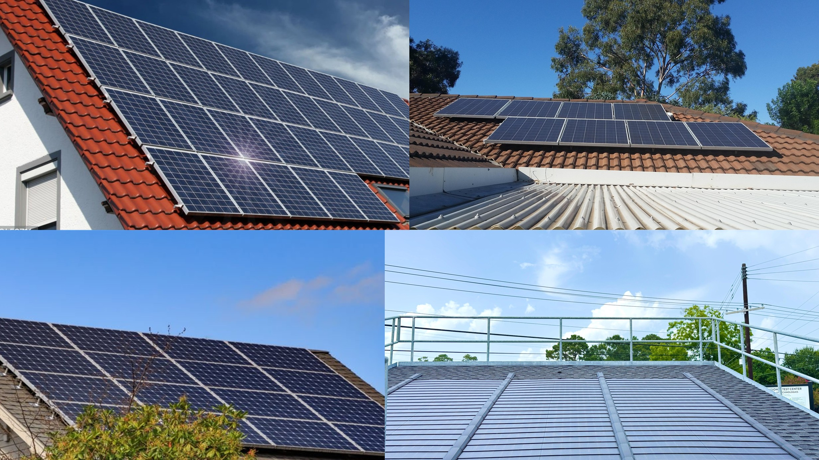
Commercial Solar
Large-Scale Systems (30 kW–MW Range) flat-roof or ground-mounted systems
Lower cost per watt due to economies of scale
Payback: ~5–10 years with PPAs, ITC, and MACRS benefits
Enhances Grid Resilience and Sustainability Goals
Residential Solar
Sized for Individual Homes (3–10 kW)
Higher Cost per Watt, Offset by Incentives
Supports Decentralized & Resilient Energy
Grid-tied with net metering; micro/string inverters
Payback: ~7–12 years, depending on site and usage

Slide 7

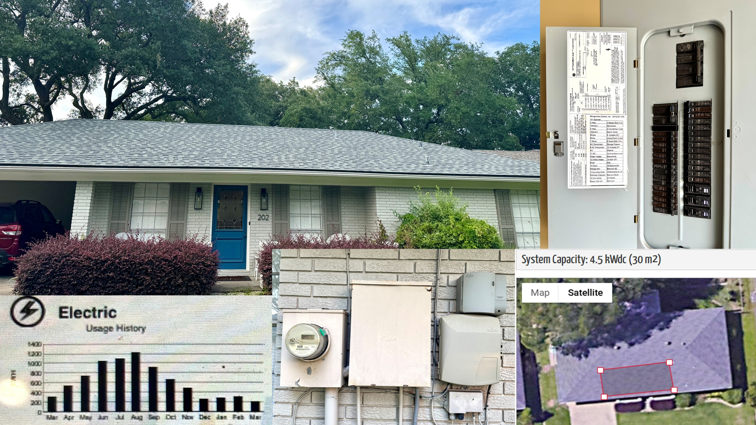
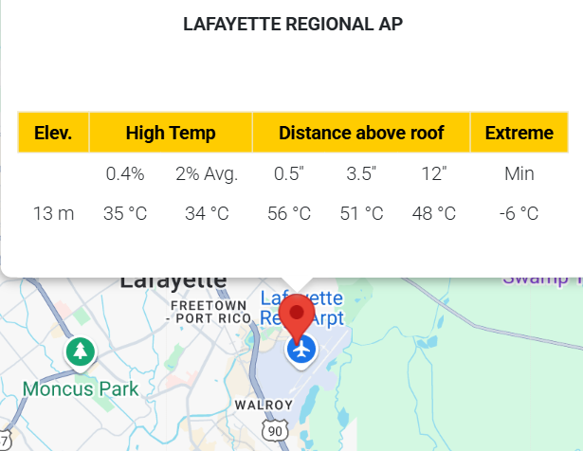
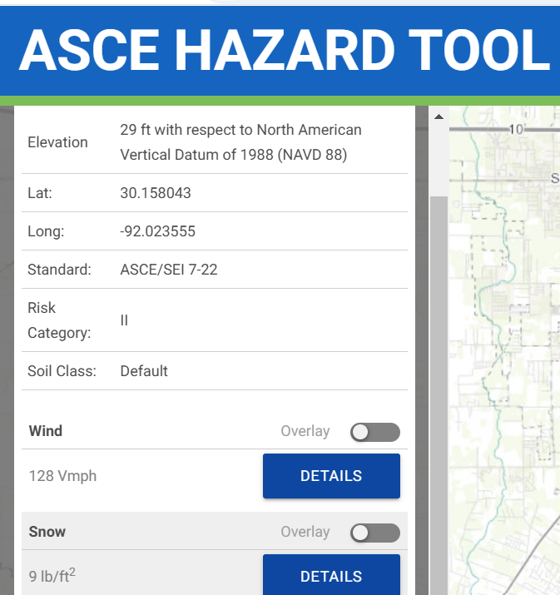
Site Survey
Customer Info
Utility
Service Entrance
General Site Information
Environmental Info
Possible Array Locations
Roof Support Structure

Slide 8

Preliminary System Sizing
System Capacity & Layout (system size, area)
Energy Yield Estimation
Cost & Incentives
Payback & Savings
Levelized Cost of Energy (LCOE)
Financial Structure (loan, interest, down payment)

Slide 9

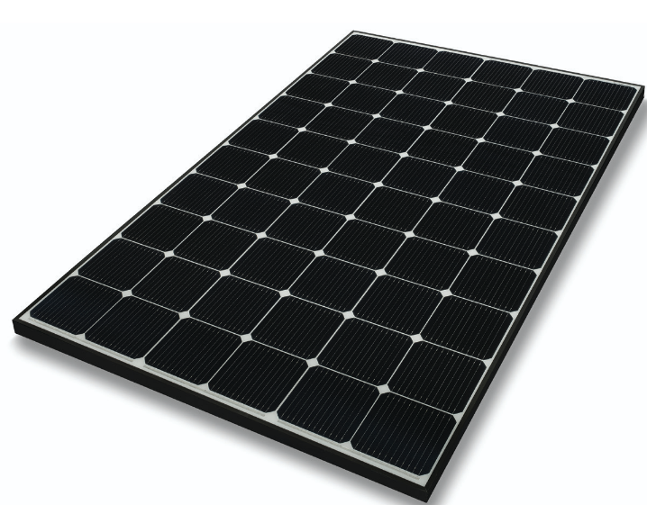
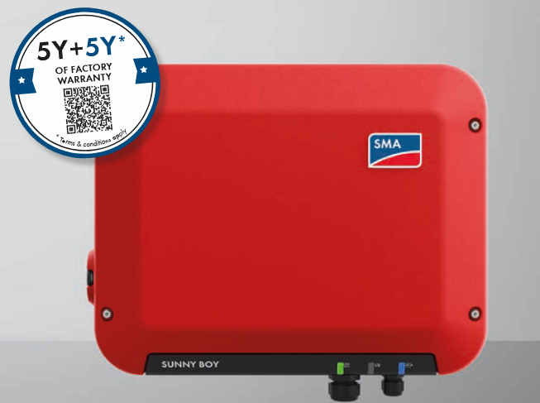
String Sizing
Component Selection (Inverter, Module)
Temperature Adjustments
Voltage & Current Limits Check
String Configuration
Physical & Electrical Layout
System Summary

Slide 10
Actual System Size
Finalized System Configuration
Cost & Incentives
Performance & Payback
Life Cycle & LCOE Analysis
Loan Financing Overview

Slide 11
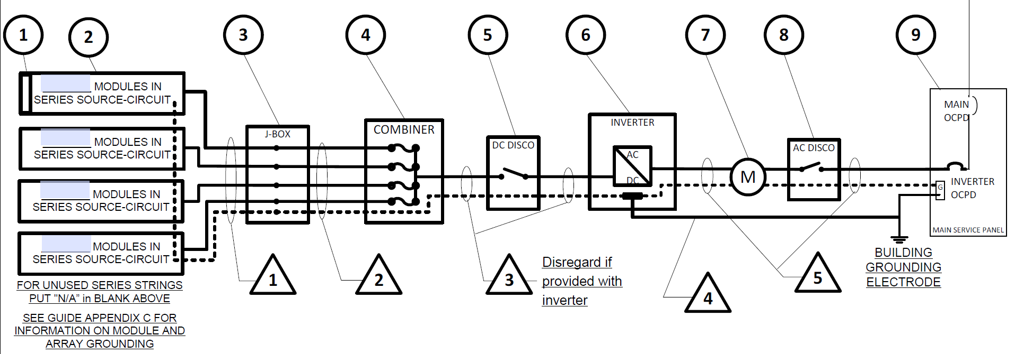
Electrical Integration
DC Side Wiring & Safety Devices (Rapid Shutdown, Disconnects, Voltage Drop)
Inverter and AC Side Integration (AC Disconnects, Output Wiring, Utility Tie-in)
Overcurrent & Grounding Protection (OCPDs, Bonding, Grounding Conductors)
System Performance (Voltage Drop)

Slide 12
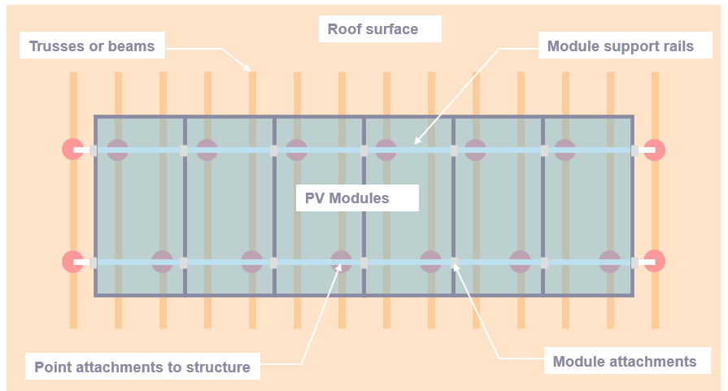
Mechanical Integration
Racking Selection & Layout (rail type, slope compatibility)
Weight & Load Distribution (array + racking in psf)
Wind & Snow Load Analysis
Attachment Point Design (lag screw size, spacing, depth)
Environmental Durability (corrosion-resistant hardware)

Slide 13

Code Compliance and Design Standards
Electrical Design – NEC Standards (Articles 690, 705, 250, 310, 110)
Structural Design – ASCE 7 & Local Codes
Equipment Certification (UL-listed, IEC 61215, IEEE 1547/1741)
Safety & Reliability Assurance (Voltage drop, grounding, OCPDs, bonding)

Slide 14
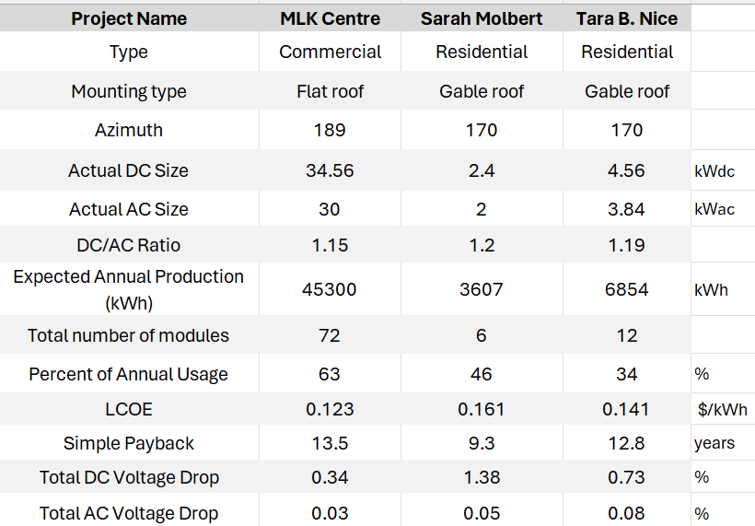
Result Summery

Slide 15
Energy and Economic Performance

Slide 16
Larger Systems Reduce Energy Cost
Smaller Systems Have Higher Cost per Watt
Energy Offset and Payback Vary by Scale
Design Orientation Affects System Efficiency
Commercial Design Minimizes Voltage Loss
Analysis

Slide 17

Theory Meets Real-World Complexity
Limitation: No Battery Storage
Policy Sensitivity in Economic Modeling
Tools Were Sufficient but could be improved
Cost is still higher for the low electricity rate in Louisiana
Discussion

Slide 18
Conclusion
Integrated Design Approach Is Key to PV Success
Commercial Systems Achieve Better Cost Efficiency
Residential Systems Need Smart Design and Incentives
Future Improvements Depend on Storage and Control

